Slide 1
IBM University Engagement Project Submission
“Exploring the Power of Agentic AI with IBM Granite and LangFlow”

Slide 2
Project Tile – [Write your project title here]
Domain of Project – [ like Agriculture / Education / Healthcare / … ]
Student Name | Recent Passport Photo | Email ID | Mobile number [WhatsApp]
Dr. Shreya Shah |  | shre9952@gmail.com
Recommended font style and size: Font Style: Arial Font Size (Heading): 28
Font Size (Content): 20

Slide 3
Problem Statement -
Problem Statement : Nutrition Agent
The Challenge
Investment analysts need to process multiple layers of information—financial reports, stock performance data, market news, and analyst opinions. Much of this information is fragmented and requires a sequence of tasks (data gathering, validation, analysis, comparison, and reporting) to generate useful insights. Manual workflows are time-consuming and prone to errors. The challenge is not just to collect market data but to automate sequential tasks that lead to actionable investment recommendations.
The Objective
Build an AI-powered Nutrition Agent that delivers personalized dietary insights and guidance for individuals, families, and health professionals. The solution should:
Personalized Diet Plans – Recommend meals based on age, health conditions, allergies, cultural preferences, and fitness goals.
Food Data RAG Retrieval – Fetch and summarize nutritional values (calories, macros, vitamins) from reliable sources.
Diet Tracking & Feedback – Allow users to log meals via text, images, or voice, and provide instant nutritional analysis.
Preventive Health Focus – Suggest diets for chronic disease management (e.g., diabetes-friendly or heart-healthy plans).
Multi-Agent System –
Nutrition Knowledge Agent (fetches nutritional data)
Diet Recommendation Agent (personalized meal plans)
Health Advisory Agent (preventive health suggestions)
Food Log & Feedback Agent (meal tracking + analysis)
Visualization Dashboard – Show daily/weekly nutrient intake, deficiencies, and progress toward health goals.

Slide 4
Proposed Solution -
Proposed Solution: AI-Powered Nutrition Agent
The proposed solution is a multi-agent AI-powered Nutrition Agent built using LangFlow, IBM watsonx.ai, and Granite Models to provide personalized, real-time dietary guidance and nutrition management. The system addresses challenges in diet planning, nutrition tracking, and preventive healthcare by delivering accurate, data-driven recommendations tailored to individual needs. At its core, the solution utilizes a Retrieval-Augmented Generation (RAG) pipeline to fetch reliable nutritional information from trusted sources such as USDA FoodData Central, WHO dietary guidelines, and nutrition databases. The retrieved information is stored in a vector database, allowing Granite models to efficiently retrieve, summarize, and explain nutritional values including calories, macronutrients, vitamins, and minerals.
The system consists of four key agents. The Nutrition Knowledge Agent retrieves and summarizes nutritional information for foods and ingredients using the RAG framework. The Diet Recommendation Agent generates personalized meal plans based on user profiles, including age, health conditions, allergies, dietary preferences, cultural requirements, and fitness goals. The Health Advisory Agent provides preventive healthcare guidance by recommending condition-specific diets such as diabetes-friendly, heart-healthy, or weight-management meal plans. The Food Log & Feedback Agent enables users to log meals through text, voice, or image inputs and instantly analyzes nutrient intake, providing actionable feedback and suggestions for improvement.
The solution also includes an interactive dashboard built with Streamlit or React, which visualizes daily and weekly nutrient consumption, calorie intake, macronutrient distribution, nutritional deficiencies, and progress toward health goals. LangFlow orchestrates the workflow between agents, ensuring seamless data retrieval, analysis, and recommendation generation. IBM watsonx.ai provides scalable AI deployment, embeddings, and governance capabilities, while Granite Models power nutrition reasoning, summarization, personalization, and conversational assistance. Overall, the solution delivers an end-to-end intelligent nutrition assistant that empowers individuals, families, and healthcare professionals to make informed dietary decisions, maintain balanced nutrition, and support long-term health and wellness goals.

Slide 5
Technology Used
Langflow platform -For designing and orchestrating multi-agent workflows visually
IBM Grainte model - for eg – ibm-granite-3-2-8b – For natural language understanding, reasoning, and personalization
IBM Cloud – It provides the infrastructure to build, deploy, and scale the Nutrition Agent efficiently. IBM Cloud enables a reliable, secure, and scalable environment for deploying the Nutrition Agent.
RAG– RAG to fetch real data first, then generate intelligent answers, making the Nutrition Agent more trustworthy and effective.
IBM Watsonx.ai - For model deployment, embeddings, and AI governance
Vector Database (FAISS/Chroma) – For RAG-based nutritional data retrieval

Slide 6
Langflow component Used -
1) Chat Input – Interface where users enter their queries, preferences, or meal details (text/voice/image).
2) IBM watsonx AI Agent - Processes user input using Granite models to generate personalized nutrition insights and recommendations.
3) Name of IBM Granite model - Granite-4.0-8B-Instruct → Fast, efficient for real-time diet recommendations
4) Chat output -Displays AI-generated responses such as diet plans, nutritional analysis, and health suggestions.
5) File component - Stores and retrieves user data, meal logs, and nutritional datasets for analysis and tracking.
6) Add name of any other component used.

Slide 7
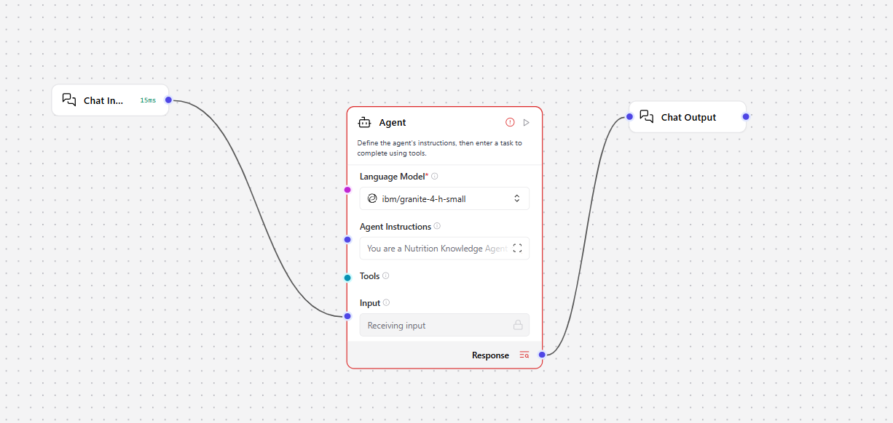
Langflow workflow -

Slide 8
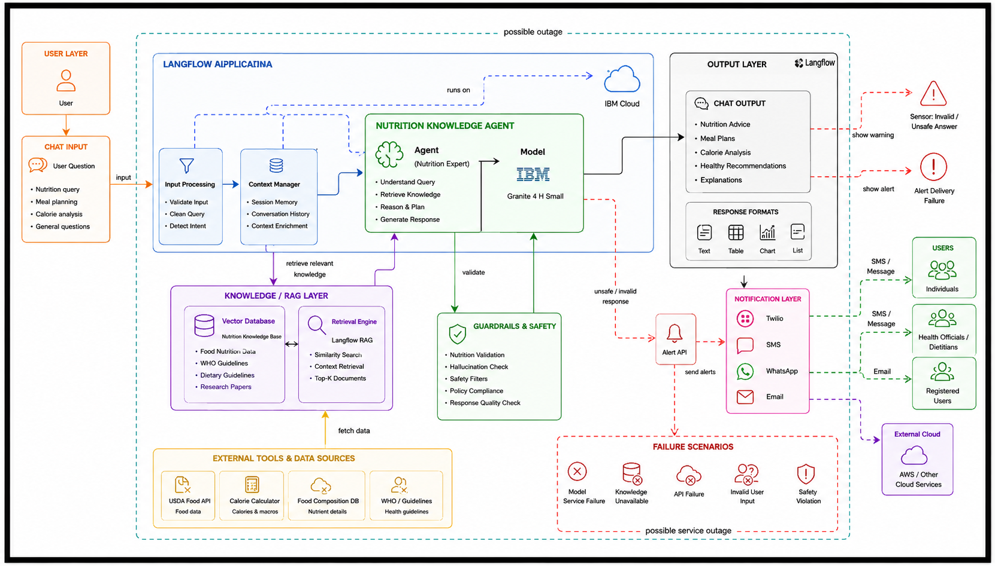
Architecture blueprint

Slide 9

Role of Agentic AI in the solution
Role of Agentic AI in the Nutrition Agent: Agentic AI serves as the intelligent decision-making and orchestration layer within the Nutrition Agent. It interprets user queries, determines the appropriate actions required, retrieves relevant nutritional knowledge from databases or RAG systems, interacts with external tools such as calorie calculators and food composition APIs, and synthesizes personalized, evidence-based recommendations. By planning, reasoning, and executing multiple steps autonomously, Agentic AI enables the system to provide accurate nutrition guidance, meal planning suggestions, dietary analysis, and contextual explanations while ensuring safety, compliance, and high-quality responses through integrated validation and guardrail mechanisms.
In addition, Agentic AI continuously evaluates the context of each interaction to adapt its recommendations according to the user's goals, dietary preferences, health conditions, and nutritional requirements. It can break down complex tasks into smaller actions, such as analyzing food intake, comparing nutritional values, identifying dietary deficiencies, and generating customized meal plans. By leveraging retrieval-augmented knowledge, tool integration, and intelligent workflow execution, the agent delivers more reliable and actionable insights than a traditional chatbot. This autonomous and context-aware capability enhances user engagement, supports informed dietary decisions, and promotes healthier lifestyle choices through personalized, scalable, and trustworthy nutrition assistance.

Slide 10
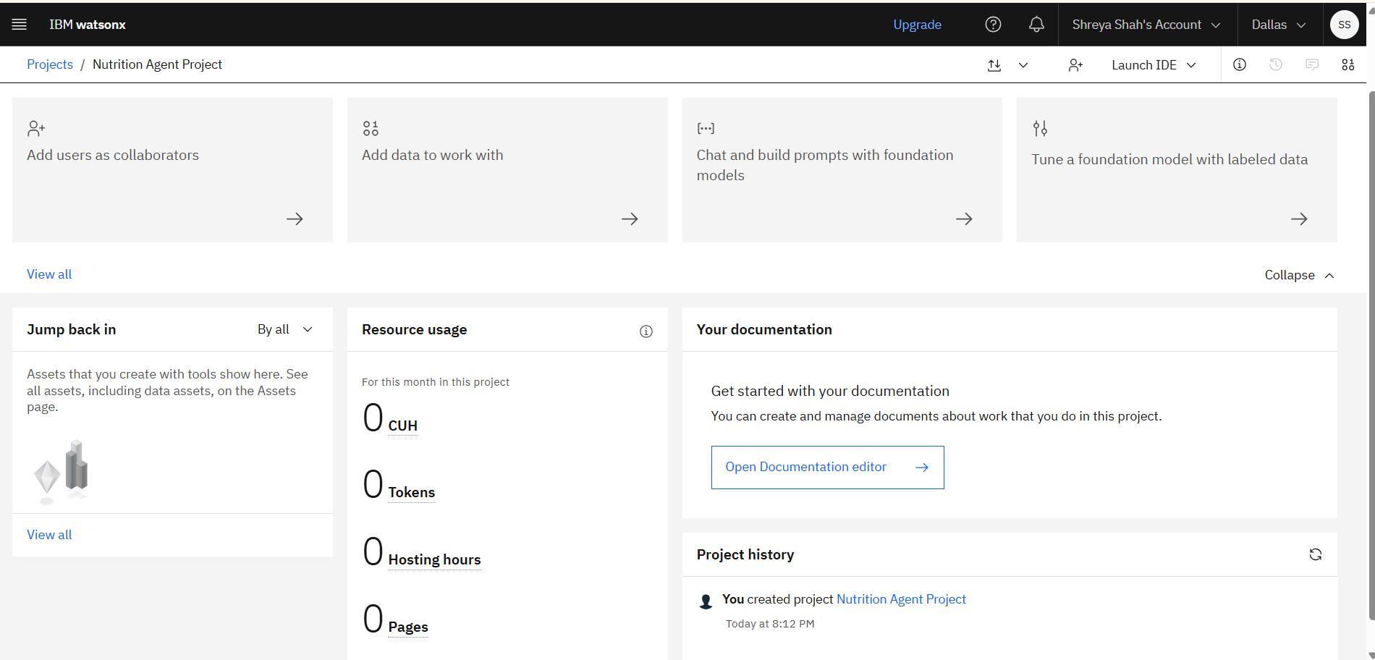
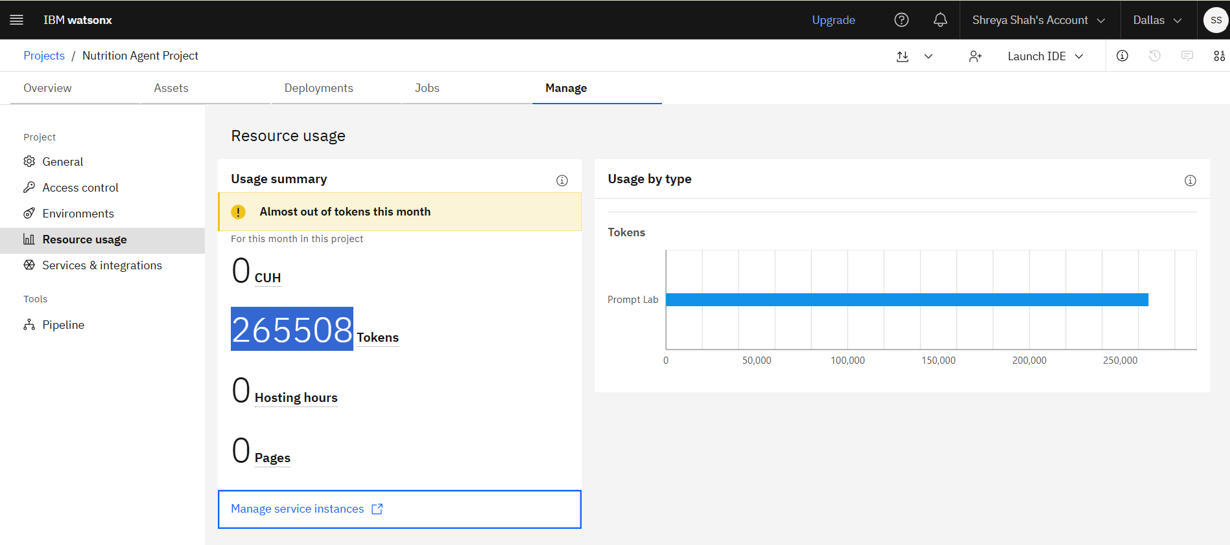
Token Usage
265508 token are used
Before Prompt
After the Prompt
·
·
·

Slide 11
Novelty and Uniqueness
The Nutrition Knowledge Agent combines Agentic AI, Retrieval-Augmented Generation (RAG), and nutrition-specific knowledge sources to deliver personalized and evidence-based dietary guidance. Unlike traditional chatbots that provide generic responses, the agent can reason, retrieve trusted nutritional information, perform dietary analysis, and generate tailored recommendations based on user needs.
Its uniqueness lies in the integration of AI-driven planning, external nutrition tools, and safety guardrails, enabling accurate meal planning, calorie analysis, and nutrition recommendations while minimizing misinformation. This transforms the system from a simple Q&A chatbot into an intelligent, context-aware nutrition assistant that provides reliable, personalized, and actionable health insights.

Slide 12
Git Hub Link
· Please create public github repository (Enable Add README button while creating repository) with format –
Please test and Paste the working Github URL –https://github.com/sbdemgit/Nutrition-Agent
Make sure you have Uploaded following three files into your github repository 1) app.json file , 2) yourproblemstatement.pdf file 3) your projectpresntation.pptx file 4)any other files
·
·
·

Slide 13
Future Scope
Integrate with fitness trackers and smart wearables for real-time health monitoring.
Provide personalized meal plans based on age, weight, and health goals.
Support multiple languages to reach a wider audience.
Add voice-based interaction for easier accessibility.
Include disease-specific nutrition guidance (e.g., diabetes, hypertension).
Develop a mobile application for on-the-go nutrition assistance.
Enable daily nutrition tracking and progress monitoring.
Expand the knowledge base with the latest nutrition research and guidelines.
These enhancements can make the Nutrition Knowledge Agent more intelligent, personalized, and user-friendly.
·
·
·

Slide 14
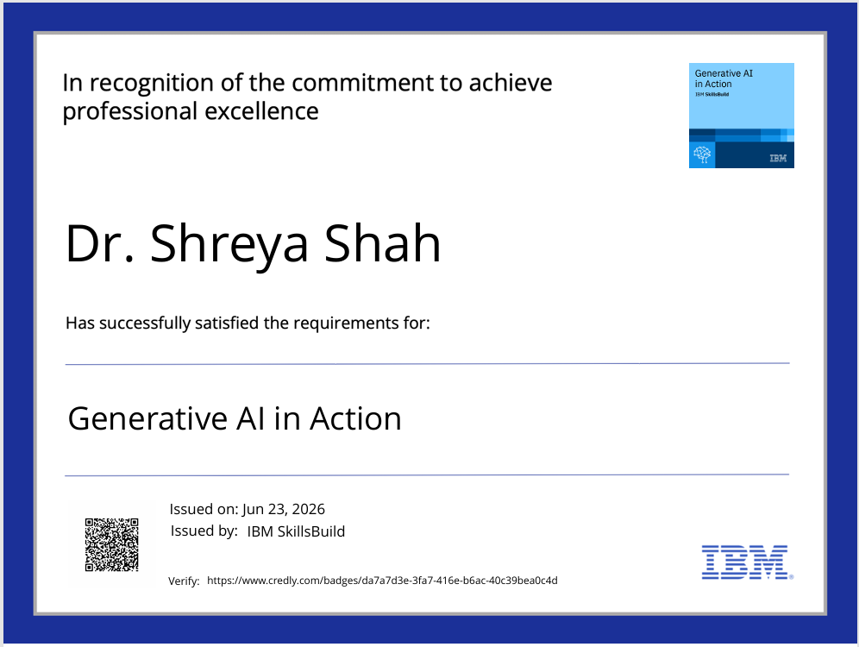
Certificates Earned:
Please add your credly certificate

Slide 15
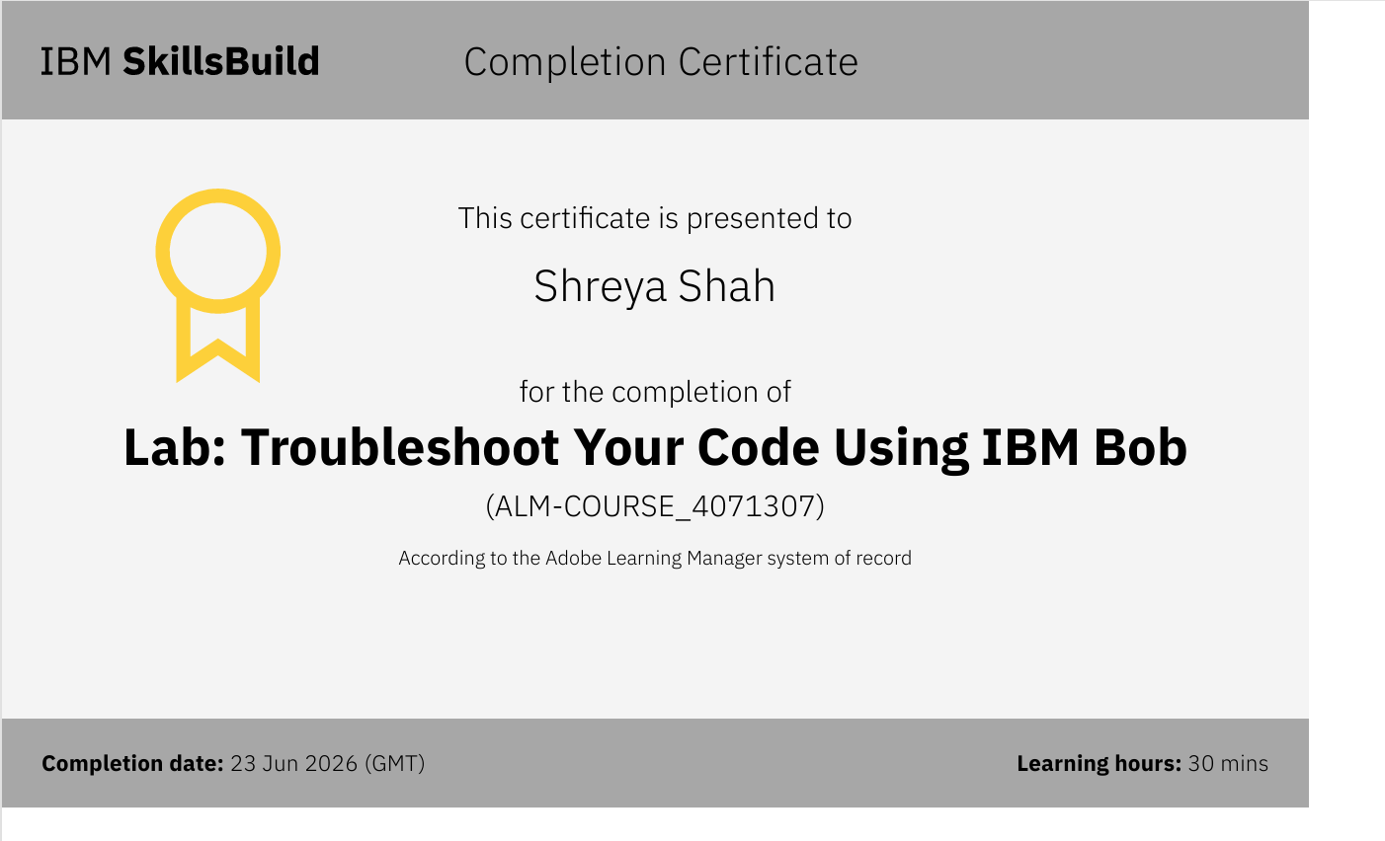
Certificates Earned:​
Add your IBM BOB Certificate

Slide 16


